Slide 1
Lecture 13
Algorithm Analysis
Arne Kutzner
Hanyang University / Seoul Korea

Slide 2
Single Source Shortest Paths

Slide 3
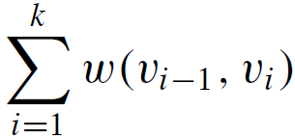
Shortest Paths
Problem: How to find the shortest route between two points on a map?
Input:
  Directed graph G = (V, E)
  Weight function w : E → R
Weight of path p = <v₀, v₁, . . . , v_{k}> :
= sum of edge weights on path p
Algorithm Analysis
L13.<number>

Slide 4
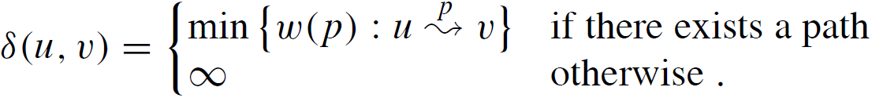
Shortest Paths (cont.)
Shortest-path weight u to v:|
Shortest path u to v is any path p such that w(p) = δ(u, v).
Algorithm Analysis
L13.<number>

Slide 5
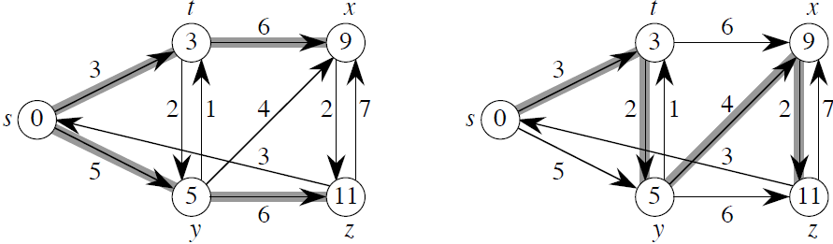
Example
Shortest paths from s
Example shows that the shortest path might not be unique.
It also shows that when we look at shortest paths from one vertex to all other vertices, the shortest paths are organized as a tree.
Algorithm Analysis
L13.<number>

Slide 6
Variants of Shortest Path Problem
Single-source: Find shortest paths from a given source vertex s ∈ V to every vertex v ∈ V.
Single-destination: Find shortest paths to a given destination vertex.
Single-pair: Find shortest path from u to v. No way known that’s better in worst case than solving single-source.
All-pairs: Find shortest path from u to v for all u, v ∈ V.
Algorithm Analysis
L13.<number>

Slide 7
Negative-Weight Edges
OK if the negative-weight cycle is not reachable from the source
If we have a negative-weight cycle, we can just keep going around it, and get w(s, v) = −∞ for all v on the cycle
Some algorithms work only if there are no negative-weight edges in the graph.
Algorithm Analysis
L13.<number>

Slide 8
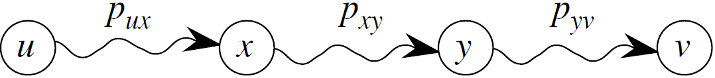
Optimal Substructure
Lemma: Any subpath of a shortest path is a shortest path.
Proof Cut-and-paste technique:
Shortest path form u to v:
We show that the assumption, that there is a shorter path form x to y, leads to a contradiction.
Algorithm Analysis
L13.<number>

Slide 9
Cycles
Shortest paths can not contain cycles:
  Already ruled out negative-weight cycles.
  Positive-weight ⇒ we can get a shorter path by omitting the cycle.
  Zero-weight: no reason to use them ⇒ assume that our solutions won’t use them.
Algorithm Analysis
L13.<number>

Slide 10
Output of Single-Source
Shortest-Path Algorithm
For each vertex v ∈ V:
d[v] = δ(s, v).
  Initially, d[v]=∞.
  Reduces as algorithms progress. But always maintain d[v] ≥ δ(s, v).
  Call d[v] a shortest-path estimate.
π[v] = predecessor of v on a shortest path from s.
  If no predecessor, π[v] = NIL.
  π induces a tree. shortest-path tree.
Algorithm Analysis
L13.<number>

Slide 11
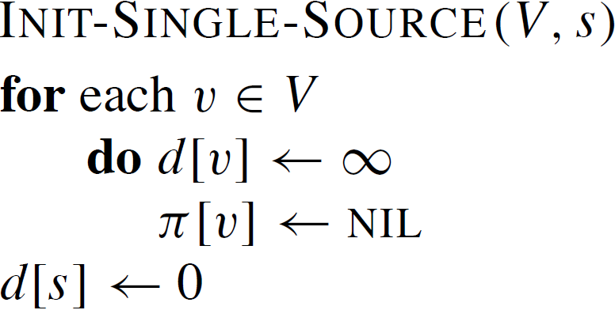
Initialization
All the shortest-paths algorithms start with INIT-SINGLE-SOURCE:
Algorithm Analysis
L13.<number>

Slide 12
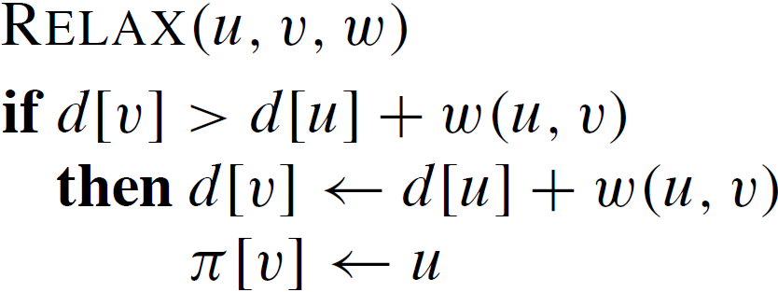
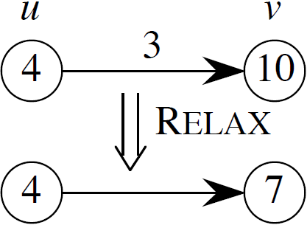
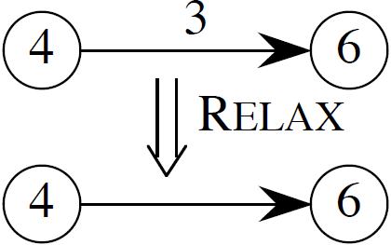
Relaxing an edge (u, v)
Algorithm Analysis
L13.<number>

Slide 13
Relaxing an edge (cont.)
All the single-source shortest-paths algorithms will
  start by calling INIT-SINGLE-SOURCE
  and then relax edges.
The algorithms differ in the order and how many times they relax each edge.
Algorithm Analysis
L13.<number>

Slide 14
Shortest-Paths Properties
Triangle inequality
For all (u, v) ∈ E, we have
δ(s, v) ≤ δ(s, u) + w(u, v).
Proof
Weight of shortest path from s to v is ≤ weight of any path from s to v. Path from s to u and then v is a path from s to v, and if we use a shortest path from s to u, its weight is δ(s, u) + w(u, v).
Algorithm Analysis
L13.<number>

Slide 15
Shortest-Paths Properties (cont.)
Upper-bound property (for Relaxing edges)
We always have d[v] ≥ δ(s, v) for all v.
Once d[v] = δ(s, v), it never changes.
No-path property (Corollary of Upper-bound prop.)
If δ(s, v)=∞, then always d[v]=∞
Convergence property If the path from s to u and finally v is a shortest path, d[u] = δ(s, u), and we call RELAX(u,v,w), then d[v] = δ(s, v) afterward.
Path relaxation property
Let p = <v₀, v₁, . . . , v_{k}> be a shortest path from s = v₀ to v_{k} . If we relax, in order, (v₀, v₁), (v₁, v₂), . . . , (v_{k−1}, v_{k}), even intermixed with other relaxations, then d[v_{k} ] = δ(s, v_{k} ).
Algorithm Analysis
L13.<number>

Slide 16
Bellman-Ford Algorithm
Allows negative-weight edges.
Computes d[v] and π[v] for all v ∈ V.
Returns TRUE if no negative-weight cycles reachable from s, FALSE otherwise
Algorithm Analysis
L13.<number>

Slide 17
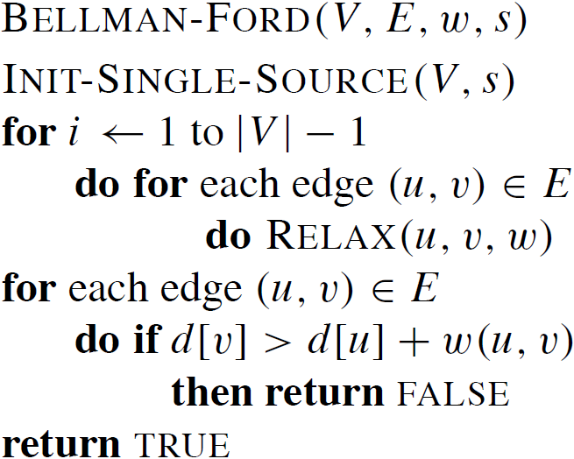
Bellman-Ford Algorithm
Core:
The first for loop relaxes all edges |V| − 1 times.
Time: Θ(VE).
Algorithm Analysis
L13.<number>

Slide 18
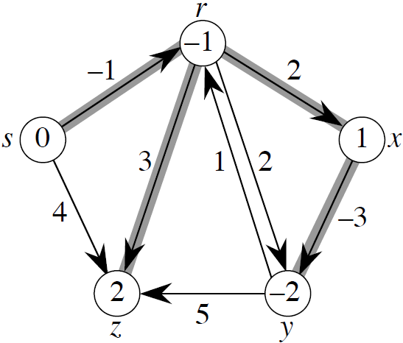
Bellman-Ford Algorithm / Example
Values you get on each pass and how quickly it converges depends on order of relaxation.
But guaranteed to converge after |V| − 1 passes, assuming no negative-weight cycles.
Algorithm Analysis
L13.<number>

Slide 19
Correctness of
Bellman-Ford Algorithm
Proof Use path-relaxation property.
Let v be reachable from s, and let p = <v₀, v₁, . . . , v_{k}> be a shortest path from s to v, where v₀ = s and v_{k} = v. Since p is acyclic, it has ≤ |V| − 1 edges, so k ≤ |V| − 1.
Each iteration of the for loop relaxes all edges:
  First iteration relaxes (v₀, v₁).
  Second iteration relaxes (v₁, v₂).
  kth iteration relaxes (v_{k−1}, v_{k}).
By the path-relaxation property, d[v] = d[v_{k} ] = δ(s, v_{k} ) = δ(s, v).
Algorithm Analysis
L13.<number>

Slide 20
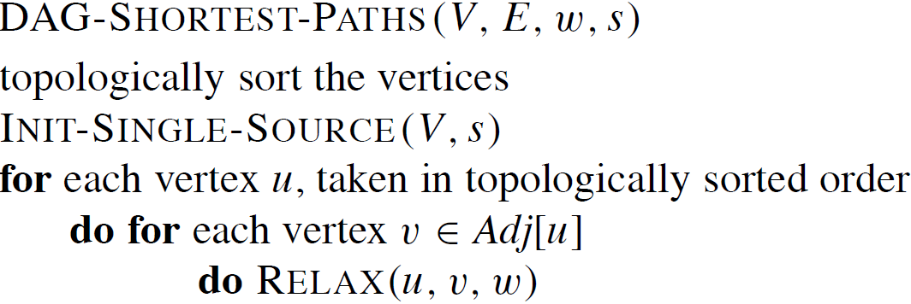
Single-Source Shortest Paths in a Directed Acyclic Graph
Since a dag, there are no negative-weight cycles
Algorithm Analysis
L13.<number>

Slide 21
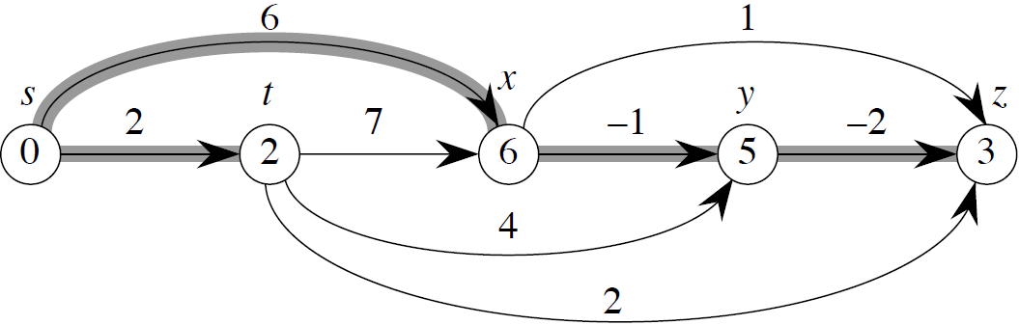
Single-Source Shortest Paths in a DAG / Example
Time: Θ(V + E).
Algorithm Analysis
L13.<number>

Slide 22
Single-Source Shortest Paths in a DAG / Correctness
Because we process vertices in topologically sorted order, edges of any path must be relaxed in order of appearance in the path.
⇒ Edges on any shortest path are relaxed in order.
⇒ By path-relaxation property, correct.
Algorithm Analysis
L13.<number>

Slide 23
Dijkstra’s Algorithm

Slide 24
Dijkstra’s Algorithm / Basics
No negative-weight edges.
Essentially a weighted version of breadth-first search
  Instead of a FIFO queue, uses a priority queue
  Keys are shortest-path weights (d[v])
Have two sets of vertices:
  S = vertices whose final shortest-path weights are determined,
  Q = priority queue = V − S
Algorithm Analysis
L13.<number>

Slide 25
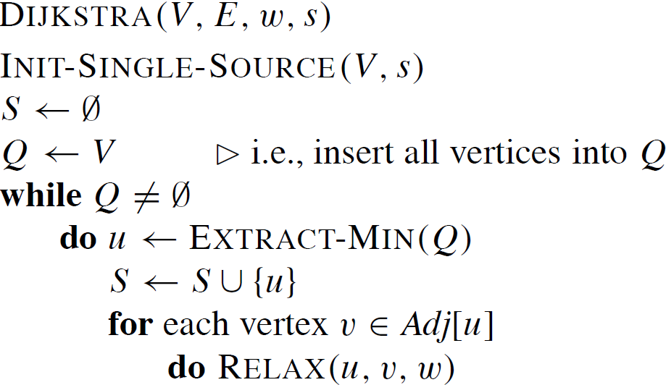
Dijkstra’s Algorithm /
Pseudocode
(Includes a call of DECREASE-KEY)
Algorithm Analysis
L13.<number>

Slide 26
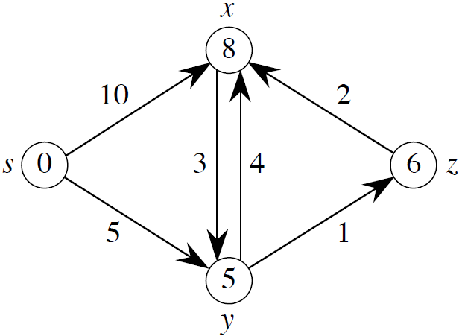
Dijkstra’s Algorithm /
Example
Algorithm Analysis
L13.<number>

Slide 27
Correctness
Loop Invariant:
At the start of each iteration of the while loop, d[v] = δ(s, v) for all v ∈ S.
Initialization:
Initially, S = ∅, so trivially true.
Termination:
At end, Q = ∅⇒S = V ⇒d[v] = δ(s, v) for all v ∈ V.
Algorithm Analysis
L13.<number>

Slide 28
Correctness /
Maintenance (loop invariant)
Need to show that d[u] = δ(s, u) when u is added to S in each iteration.
Suppose there exists u such that d[u] ≠ δ(s, u). Without loss of generality, let u be the first vertex for which d[u] ≠ δ(s, u) when u is added to S.
Observations:
  • u ≠ s, since d[s] = δ(s, s) = 0.
  • Therefore, s ∈ S, so S ≠ ∅.
  • There must be some path from s to u, since otherwise d[u] = δ(s, u) = ∞ by no-path property.
Algorithm Analysis
L13.<number>

Slide 29
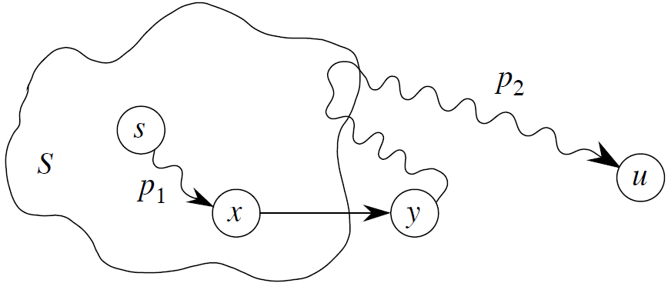
Correctness (cont.) /
Maintenance (loop invariant)
So, there is a shortest path p from s to u.
Just before u is added to S, path p connects a vertex in S (i.e., s) to a vertex in V − S (i.e., u).
Let y be first vertex along p that is in V − S, and let x ∈ S be y’s predecessor.
Algorithm Analysis
L13.<number>

Slide 30
Correctness (cont.) /
Maintenance (loop invariant)
Claim: d[y] = δ(s, y) when u is added to S.
Proof: x ∈ S and u is the first vertex such that d[u] ≠ δ(s, u) when u is added to S ⇒d[x] = δ(s, x) when x is added to S. Relaxed (x, y) at that time, so by the convergence property, d[y] = δ(s, y).
Algorithm Analysis
L13.<number>

Slide 31
Correctness (cont.) /
Maintenance (loop invariant)
Now can get a contradiction to
d[u] ≠ δ(s, u):
  y is on shortest path from s to u, and all edge weights are nonnegative
  ⇒ δ(s, y) ≤ δ(s, u)
  ⇒ d[y] = δ(s, y) ≤ δ(s, u)
  ≤ d[u] (upper-bound property)
  Also, both y and u were in Q when we chose u,
  so d[u] ≤ d[y]
  ⇒ d[u] = d[y]
Therefore, d[y] = δ(s, y) = δ(s, u) = d[u].
Contradicts assumption that d[u] ≠ δ(s, u). Hence, Dijkstra’s algorithm is correct.
Algorithm Analysis
L13.<number>

Slide 32
Analysis
Like Prim’s algorithm, depends on implementation of priority queue.
If binary heap, each operation (EXTRACT-MIN, DECREASE-KEY) takes
O(lg V) time⇒ O((E+V) lg V) = O(E lg V).
If a Fibonacci heap:
  Each Decrease-Key takes O(1) amortized time.
  There are O(V) other operations, taking O(lg V) amortized time each.
  Therefore, time is O(V lg V + E).
Algorithm Analysis
L13.<number>

